Slide 1

Diagnosing Error in Temporal Action Detectors
Humam Alwassel*, Fabian Caba Heilbron*, Victor Escorcia*, Bernard Ghanem
King Abdullah University of Science and Technology (KAUST), Saudi Arabia
ECCV 2018
* Equal contribution

Slide 2
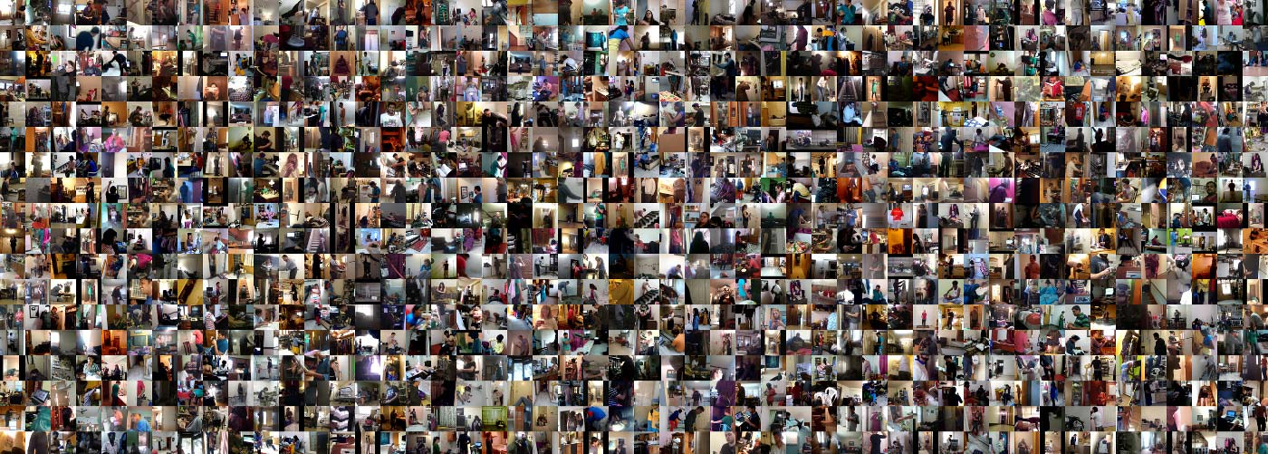



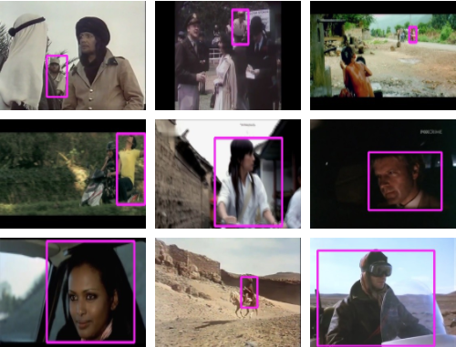
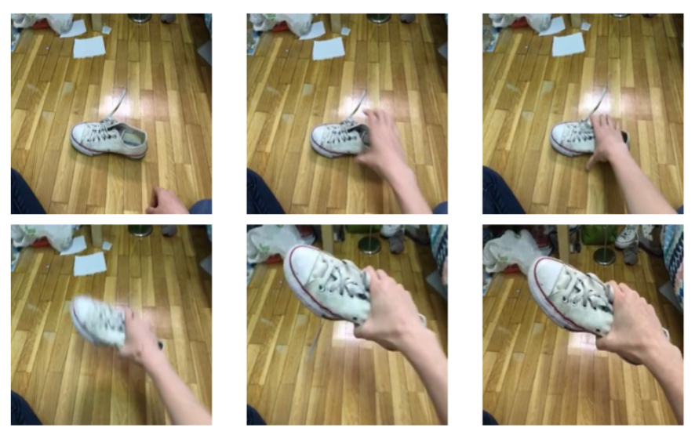
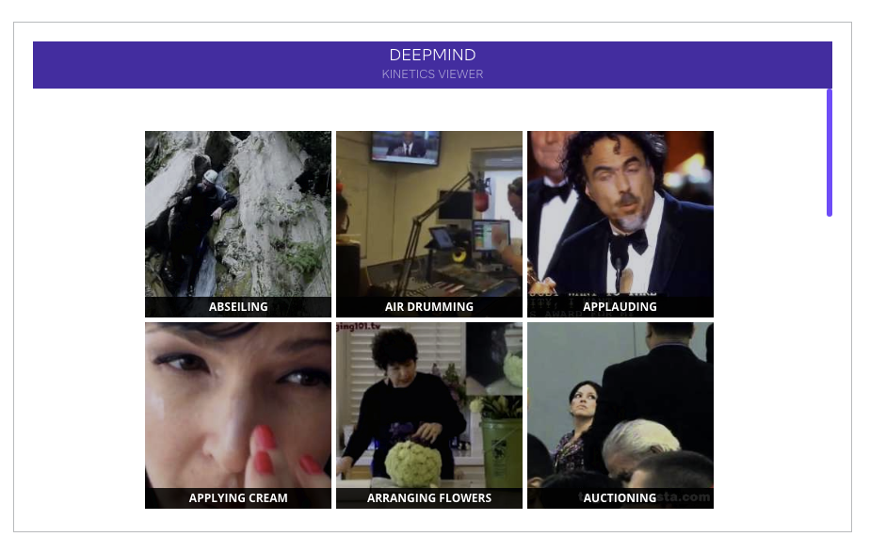
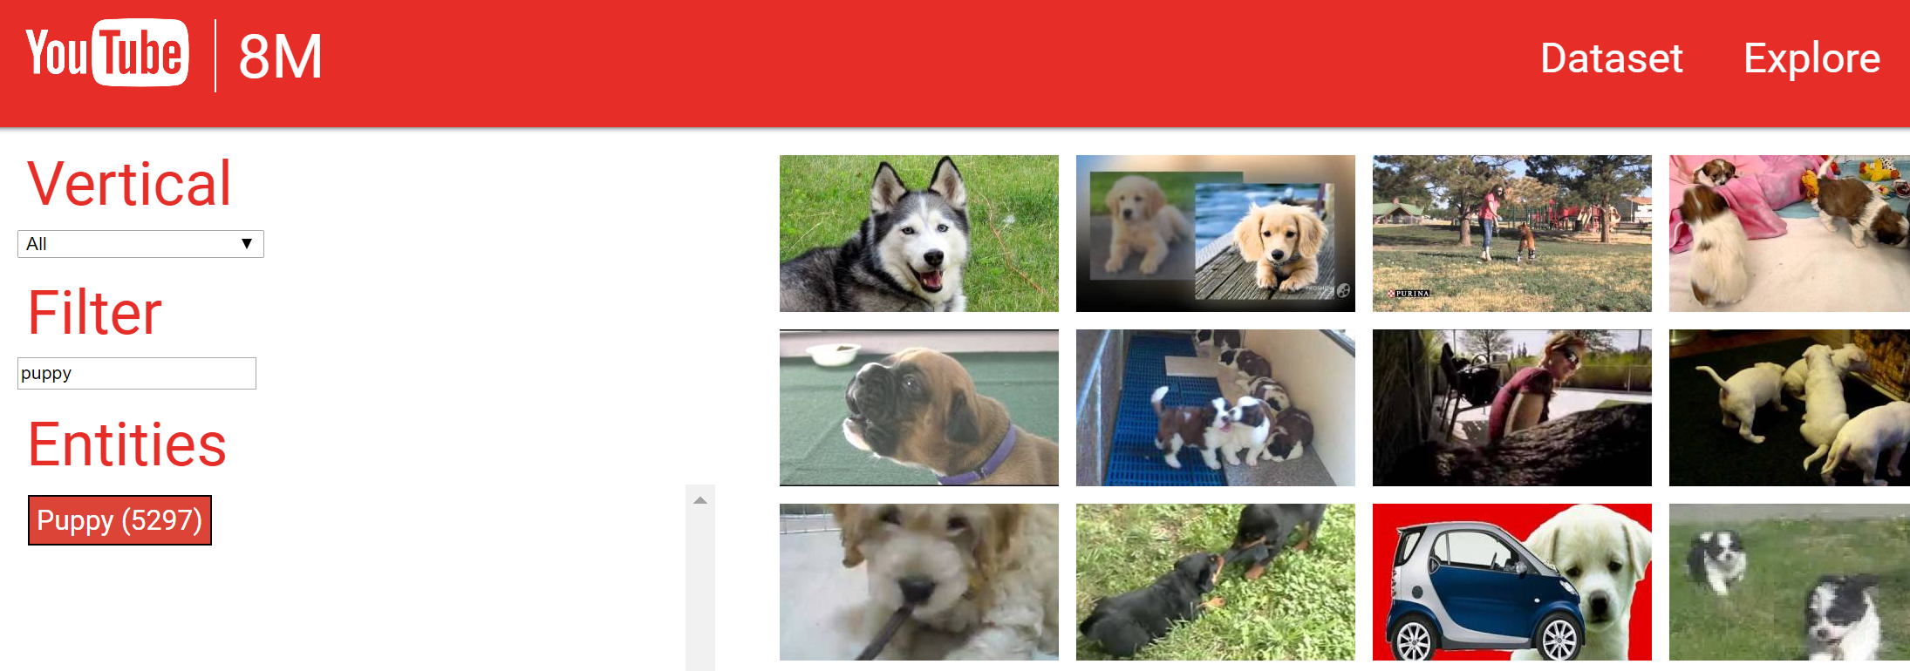


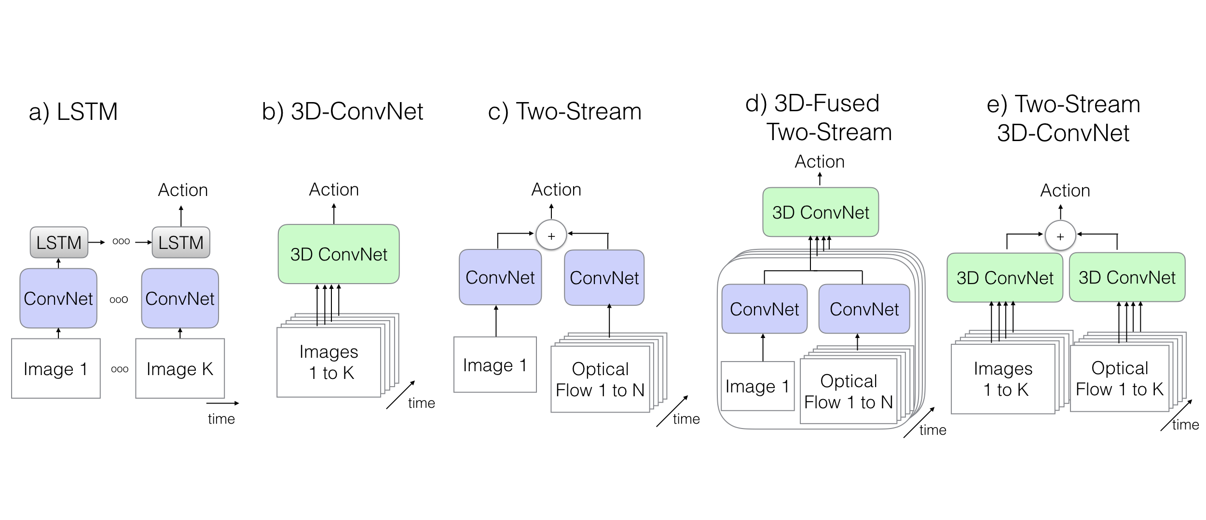
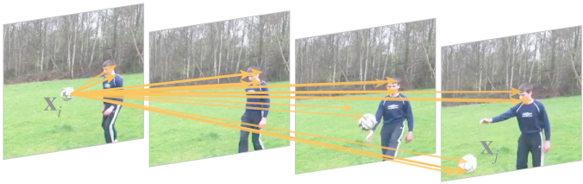
Charades
20BN-SOMETHING SOMETHING
AVA
Kinetics
In the last years, there has been a crescent interest for understanding actions in videos. We can evidence that on the tremendous efforts on collecting large scale datasets, and the development of novel algorithms and video-based architectures.

Slide 3
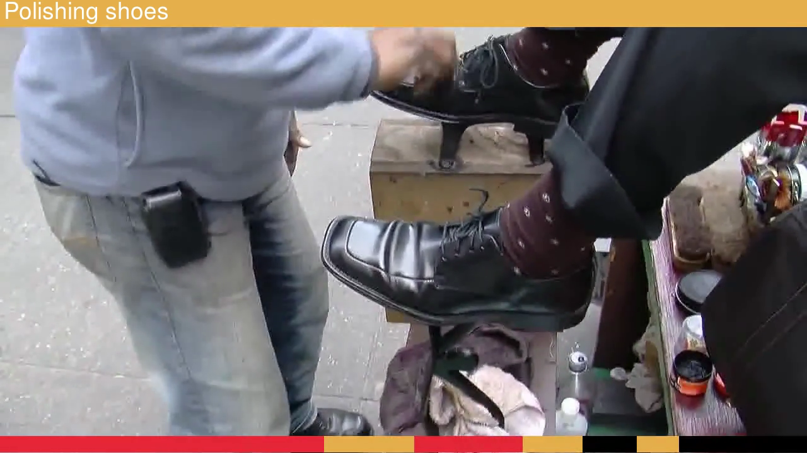
Yet, we have not found the master algorithm capable to skim quickly over an untrimmed video and return the relevant parts associated with the action of interest.

Slide 4
Progress on this area has increased over the years. However, it is still unclear how far we are to solve the problem.

Slide 5
What makes an algorithm more effective than another?
What makes an action hard to localize?
Is the uncertainty of the temporal boundaries impeding the development of new algorithms?
Moreover, relying on a single scalar value to dictate progress does not describe the full picture of the problem.

Slide 6

To this end, we introduce a new diagnostic tool that goes beyond a single scalar metric and provides an in-depth analysis of temporal action detectors in videos.

Slide 7
Our tool allows to: (i) inform and measure the impact of the errors made by any given algorithm; (ii) detect the action characteristics with more impact in the performance; (iii) identify the action characteristics difficult to retrieve; and (iv) establish a comparison among different methods in terms of action characteristics and error types.

Slide 8
Dataset Characterization
To go beyond a single metric, it is relevant to consider other characteristics of the actions and the dataset

Slide 9
But First:
Let’s Play Some Games

Slide 10
guess-the-action: In this game you have to guess what action (one out of three options) could happen in the context of the depicted video clip.

Slide 11
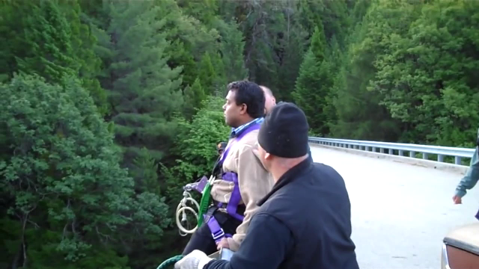
Bungee Jumping
The answer is Bungee Jumping. Most probably you used information about scene (bridge, river) and objects (elastic cord, helmet) to predict your answering when playing. We argue those signal are strong evidence to determine if the video is in temporal context.

Slide 12
let-us-agree: the goal is to pick the frame that best represents when the action Long Jump ends.

Slide 13
?
There is not a unanimous answer for this game. 67% of our labs' colleagues picked frame B as the correct answer. The question naturally arises, can we precisely localize actions in time?

Slide 14

Intrigued by these toy examples, we decided two conduct two formal online user studies with the aim of quantifying the amount of temporal context and temporal boundaries agreement in current datasets for temporal action localization.

Slide 15
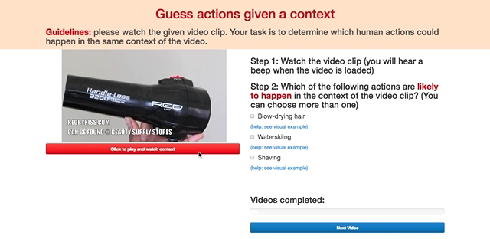
User Study I: Temporal Context of Action
Each participant's task is to watch a 5-second video clip and pick, from a given list, all the human actions that (s)he believes could happen in the context of the video clip. Here, we illustrate the UI used to collect the data.

Slide 16
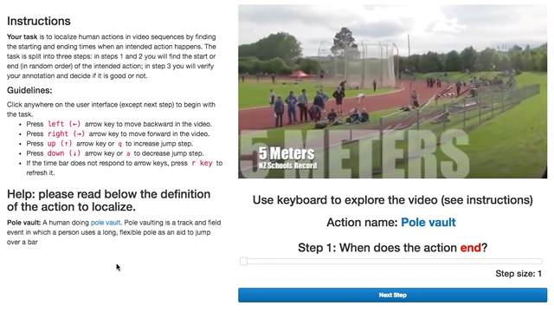
User Study II: Finding Temporal Boundaries
The task consisted in defining the boundaries of an already spotted action. Additionally, we asked the participants to annotate each temporal boundary individually. The video illustrates how to complete this task.

Slide 17
We use the collected data to categorize the ground truth instances into six action characteristics: context size, context distance, agreement, coverage, length, and the number of instances.

Slide 18
Distribution of instance per action characteristic. We report the percentage of ground truth instances belonging to each characteristic bucket.

Slide 19
Categorization of Temporal Localization Errors

Slide 20
When designing new methods, researchers in the field often identify an error source current algorithms fail to fully address. However, the field lacks a detailed categorization of the errors relevant to the temporal localization problem.

Slide 21
BG=Background Error; CON=Confusion Error; LOC=Localization Error;
WL=Wrong Label Error; DD=Double Detection Error; TP=True Positive.
To this end, we propose in this section a taxonomy of the errors relevant to action localization. We classify False Positive Predictions into five categories. The Figure illustrates the categories of errors.

Slide 22
False Positive Analysis

Slide 23
We illustrate the use of our tool comparing the top-4 awarded algorithms in the ActivityNet v1.3 benchmark.

Slide 24
Let’s make another quiz before diving into the analysis of the the distribution of false positive errors.

Slide 25
(A) (B) (C) (D)
31.70 (b) 16.52 (c) 31.83 (d) 32.99
Can you match the distribution of false positives with the average-mAP?

Slide 26
(A) (B) (C) (D)
31.70 (b) 16.52 (c) 31.83 (d) 32.99
If your answer was (A-d), (B-c), (C-a), (D-b), congratulations! You belong to the 5% of our colleagues that translates mAP into false positive errors.
90% of our colleagues can predict D-b. However, disambiguating among the rest is subject of interesting discussions.

Slide 27
The false positive profiles allow examining the behaviors of the different detector components such as the classifier and scoring function. For example, we can see a high wrong label and confusion errors for BU, indicating a weakness in BU’s classifier.
More details and insights about other methods and trends are discussed in Section 5.

Slide 28
Besides of categorizing and identifying the types of errors made by an algorithm, our tool also reveals the expected improvement by removing a particular kind of error.
In this case, all the methods would benefit the most from reducing localization errors.

Slide 29
False Negative Analysis

Slide 30
We also study the sensitivity of each method to the collected action characteristics.
More details are provided in Section 6.

Slide 31
Finally, we consider the kind of actions that the algorithms struggle to retrieve.
More details are provided in Section 7.

Slide 32
Diagnosing Error in Temporal Action Detectors
Humam Alwassel*, Fabian Caba Heilbron*, Victor Escorcia*, Bernard Ghanem
King Abdullah University of Science and Technology (KAUST), Saudi Arabia

